Slide 1
Welcome!
REDCap + R Workshop
REDCapCon 2023

Slide 2

Stephan

Slide 3

Will
Notes:
TODO: add headshot

Slide 4

Assumptions
You are somewhat familiar with REDCap
You have basic knowledge of R
You're interested in learning how to integrate REDCap and R so you can use these skills for your own work
You'd like to meet others who are also interested in this
Notes:
… but don't necessarily have in-depth knowledge about complex databases with repeated and longitudinal instruments
… but aren't necessarily an expert in using it to clean, visualize, or model data
…or at least aren't opposed to meeting them!

Slide 5
Getting Onto Posit Cloud
Notes:
We’ll be using Posit Cloud today. Posit Cloud is a web version of the RStudio IDE, and we’ve set up a Posit Cloud environment specifically for this session so you don’t have to download or install anything on your computer.
However after the course we highly recommend you download the RStudio IDE from the Posit website.

Slide 6
https://posit.cloud/content/6465016
Notes:
Log in or sign up if you don’t have an account.

Slide 7
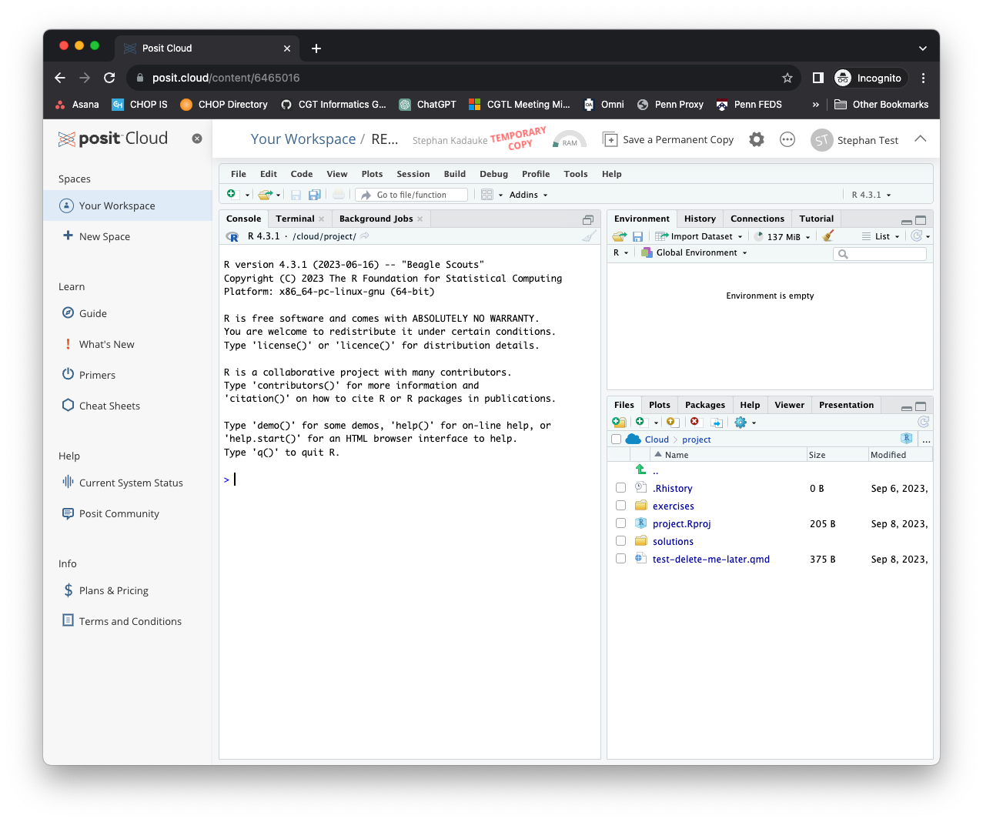
Notes:
X out the left sidebar so you have more real estate on the screen

Slide 8
Your Turn
In the Files pane on the bottom right, find the exercises folder. Click on it.
Then click on the file named 00_welcome.qmd.
A new pane will pop up on the top left with the contents of that file. Read what it says and follow the instructions to complete the exercise.
Notes:
(When you’re done, consider getting up and help out others!)

Slide 9
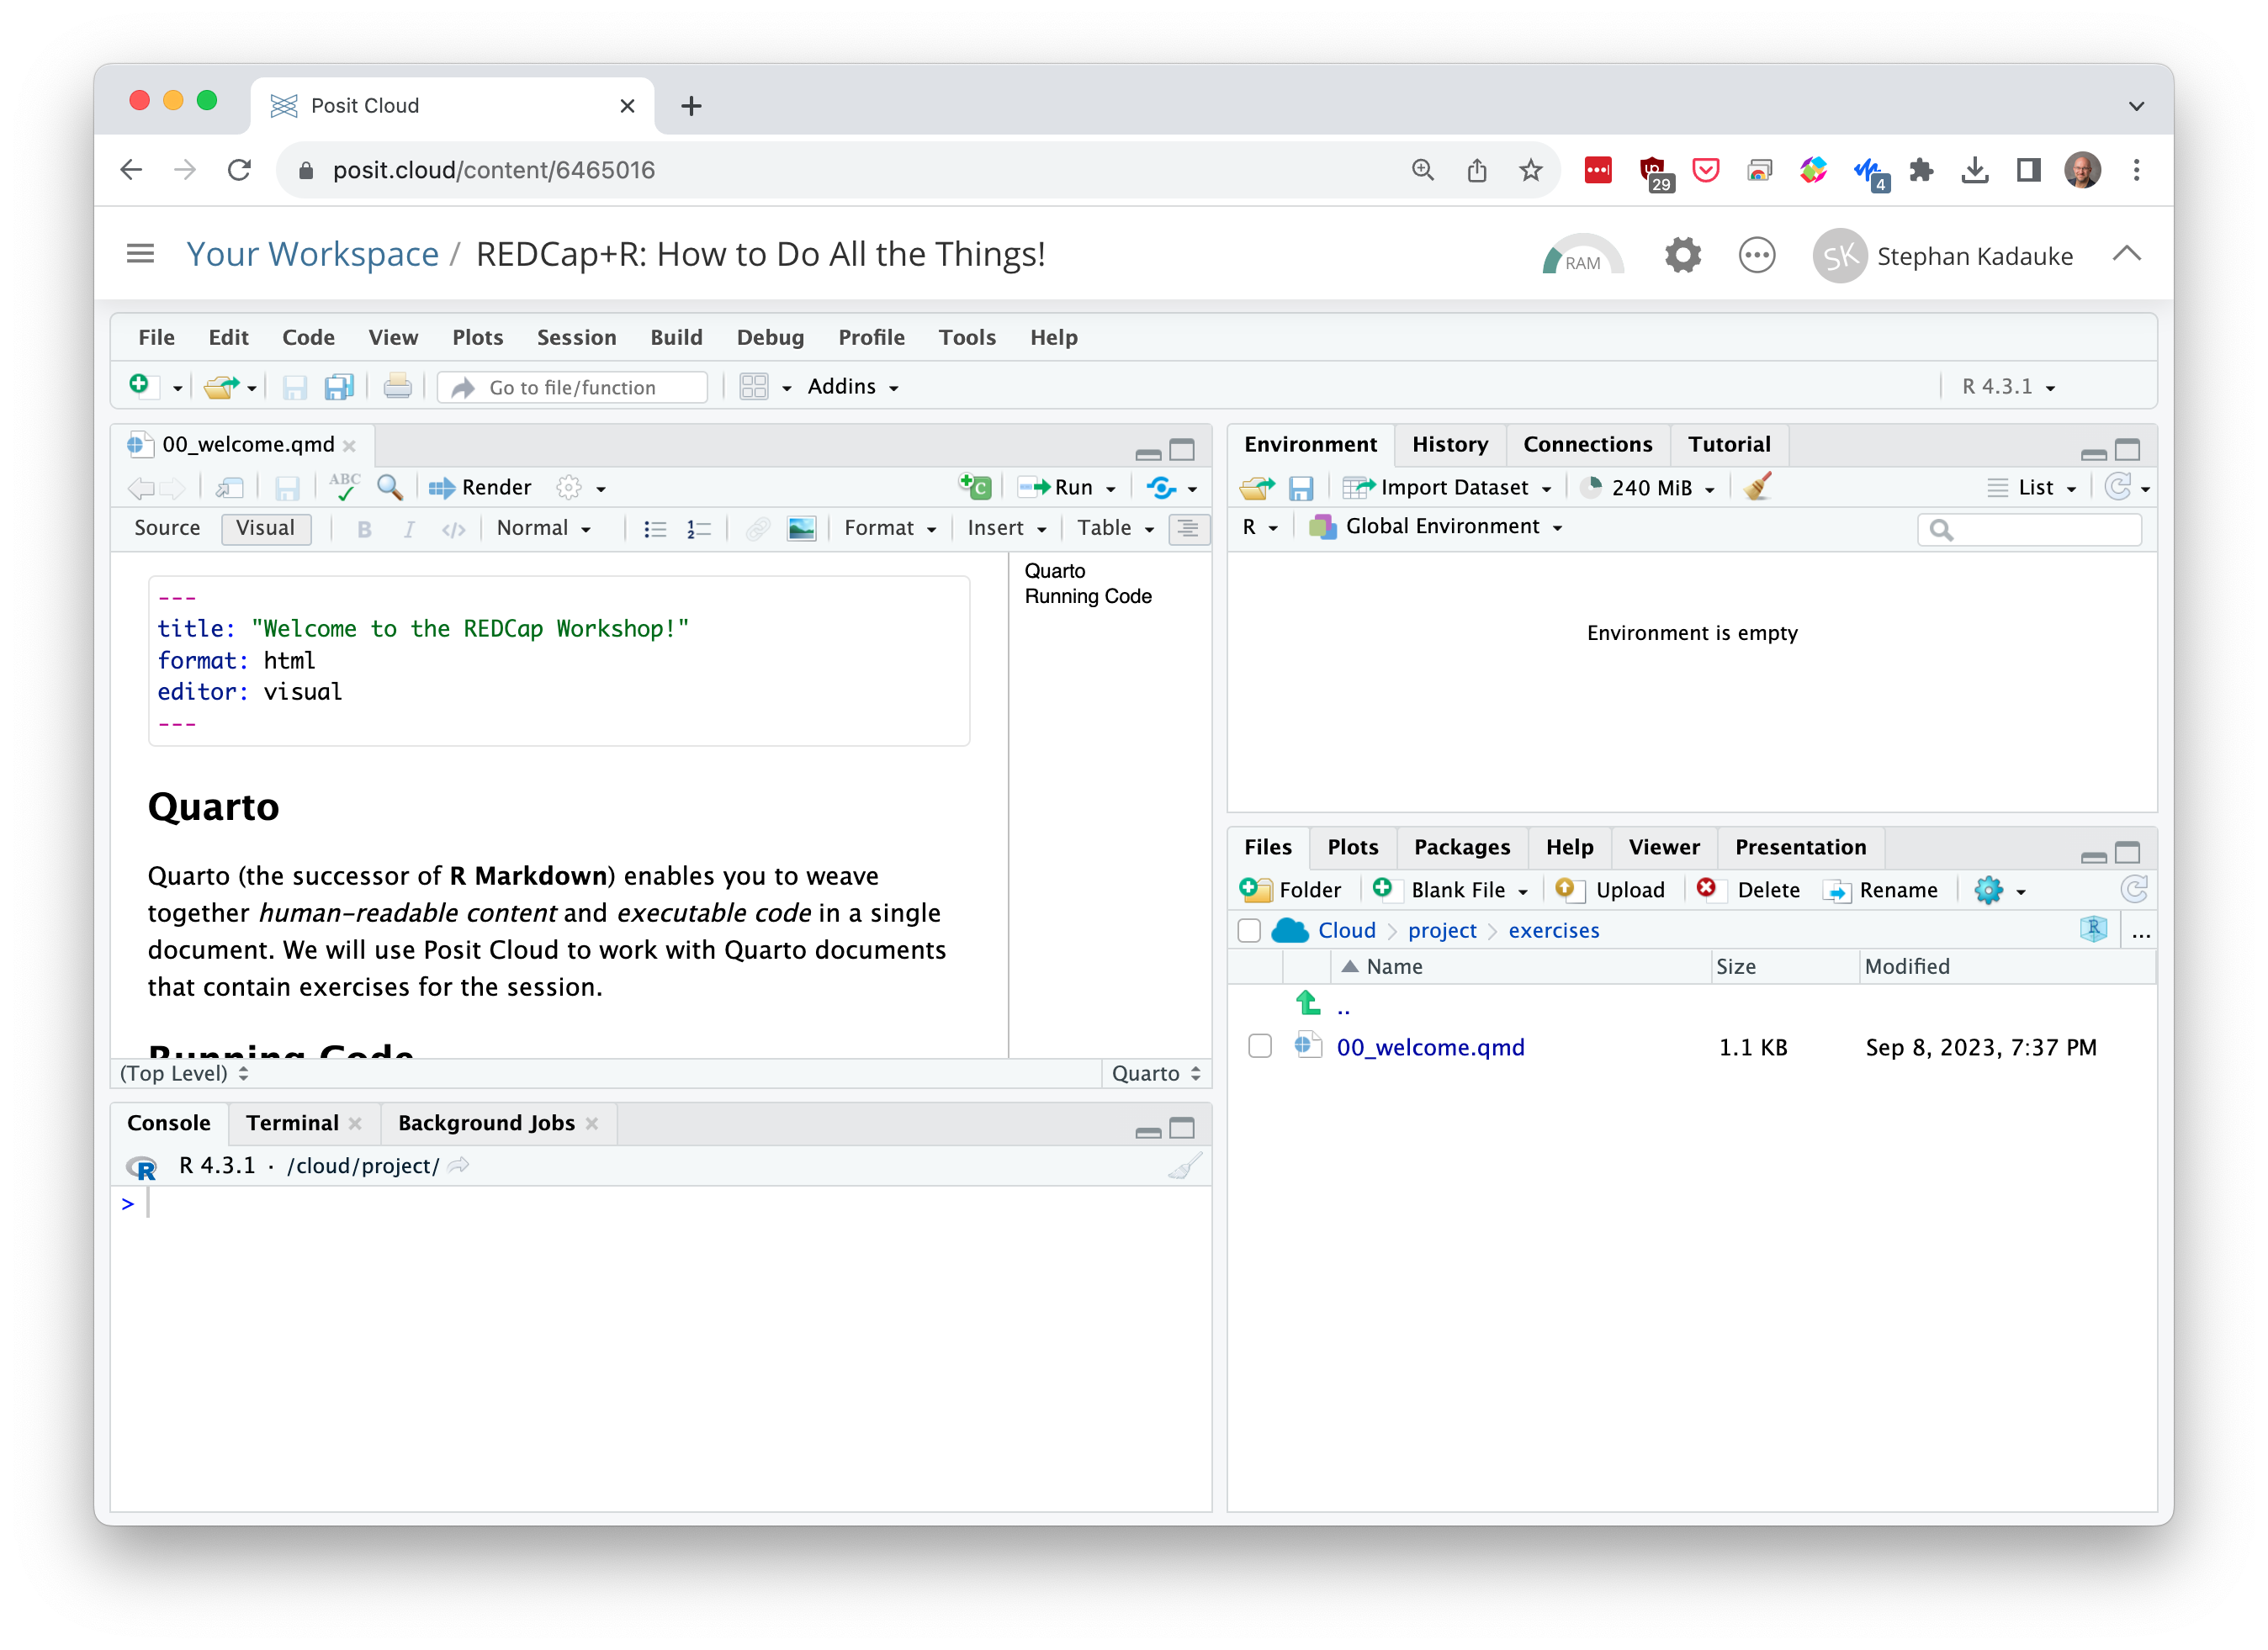
Environment
Editor
Files
(and other stuff)
Console
Notes:
Let’s talk about the RStudio or Posit IDE. Here is what it looks like.
On the top left is the editor. This is where you enter code.
On the top right is the Environment. The environment allows you to look at the data that’s loaded into R. Interacting with data in the environment tab provides some of the functionality you may be familiar with from working in Excel.
The Console is on the bottom left. You can use the console quickly run an individual R command, like install a package. We probably won’t use the console much today.
The pane I have labeled “Files and other stuff” has a couple of tabs. The most important one for today is the “Files,” and you’ve already explored that. But here’s also where help pages for R commands will show.
Now redo the exercise and run the code chunks.

Slide 10


Notes:
Let’s talk about Quarto. Quarto lets you write computational documents. These are documents that contain human readable content and computer code. We will use Quarto in this session and we encourage you to continue using it consistently in your future work when you do anything in R. In fact, this is the strongest recommendation I will make to you today.

Slide 11
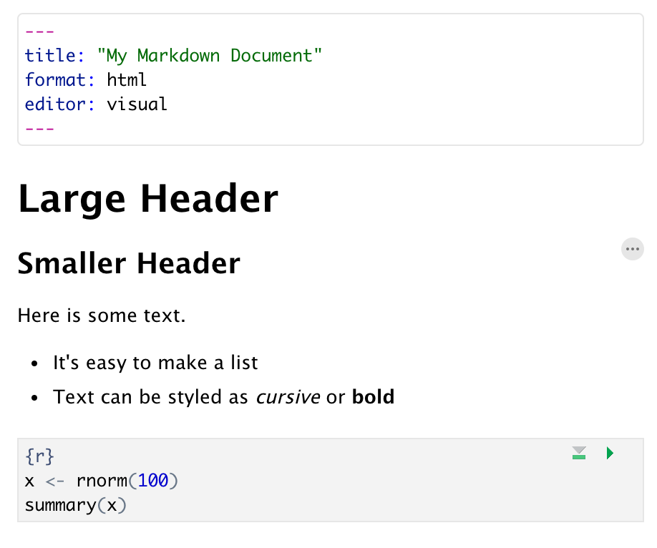
Anatomy of a Quarto Document
Header
Header
Text (w/ formatting)
Code chunk
Notes:
Quarto documents are composed of 3 basic building blocks.
**The first is the Header which includes pieces like the name of the document, the document’s author, and the desired output format when the document is assembled.
**The second block is the text. Quarto documents can be marked in ways that promote readability with formatting styles.
**Finally, there are code chunks. Code chunks include include R code that can be executed to output results.

Slide 12
5 Minute Intro to R

Slide 13
The Data Analysis Pipeline
Notes:
The Data Analysis pipeline includes importing data, cleaning or tidying it, after which you can visualize and model it to gain insights into the data. Finally, you need to communicate these insights. One of the reasons we use the Post IDE and Quarto is because they provide a lot of tools to make every one of these steps easier.
The first step in the data analysis pipeline is to import the data into the R environment. Data can be in the form of Excel or CSV files, or they can come from online resources. For today, we’ll focus on getting data from REDCap into R.

Slide 14
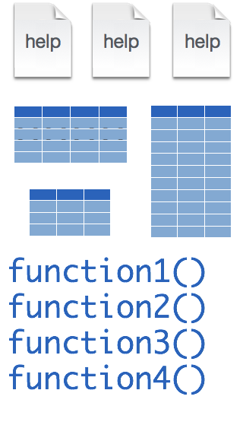
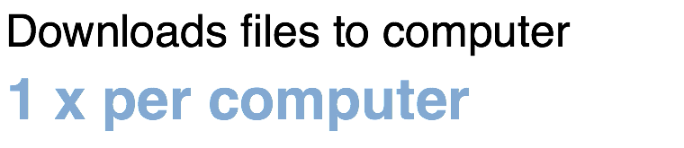
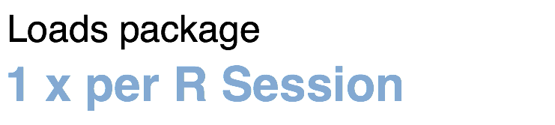
Installing and loading R packages
REDCapR
install.packages("REDCapR")
library("REDCapR")
Notes:
Much of R’s functionality comes in open source packages. Two of these packages we’ll discuss in some detail today are the REDCapR and the REDCapTidieR packages.
When you download the REDCapR package, what you get are functions, documentation, and sometimes data.
Fortunately, installing packages is super easy, with the command install.packages. So let’s say you want to install a package named “REDCapR”. You go to the R Console and type install.packages(“tidyverse”).
Each package you want to use needs to be installed only once on each computer. However, in order to use the functions or data in the package, you also need to load the package. This is done with the command “library”. So to enable all the functions in the “REDCapR” package, you type library(“REDCapR”). And in fact, library(REDCapR) was the very first line of code in the code chunk you just ran.
Packages remain loaded until you quit R. So every time you start a new R session you have to load each package that you want to use again.

Slide 15
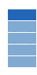


retrieve_credential_local()
creds <- retrieve_credential_local(file_name, pid)
csv
Notes:
Let’s look at the next line of code in that chunk. It reads, …
There is a lot of R going on in the second line of code. But at a high level, there’s an object named “creds” that receives the output of a function called “retrieve_credential_local”. This function looks at a special CSV file with REDCap credentials, and need a REDCap project ID, and then returns some information.

Slide 16
object
(stores output)
function
(does stuff)
arguments
(inputs)
creds <- retrieve_credential_local(file_name, pid)
assignment operator
(“gets”)
Notes:
Let’s look a little bit closer at what happens here. First, we have a function. Functions take one or more inputs and they return an output.
** The inputs are called arguments and go into parentheses.
** You can capture the output in an object,
** using the assignment operator. This is a smaller than sign followed by a minus or dash and looks a little like an arrow pointing left. This is very similar to having a single equals sign, but one of the quirks of R is that they use this arrow sort of assignment operator. People pronounce this operator as “gets” as in creds ”gets” retrieve_credential_local of filename and pid.
There is a lot of R going on in the second line of code.
…
Once, the Tidyverse package has been loaded via library, we can import CSV files using the read_csv() function.
Here is a template for how to use the read_csv function to create a data frame object from a CSV file.
You start with the name of a data frame object then you have this left-ward arrow then read_csv and then the file name in parentheses.

Slide 17
uri <- creds$redcap_uri
creds
redcap_uri | "https://redcap.chop.edu/api/"
username | "myusername"
project_id | 1
token | "37BCFC38D45F10C47EAF4D8B97BFC32F"
comment | CAR-T cell trials
uri
"https://redcap.chop.edu/api/"
Notes:
Let’s look at the next line. This says, uri <- creds $ redcap_uri
The creds object which we just made in the previous command is a *list*. A list is an object that contains other objects. In this case, creds contains the following elements: redcap_uri, username, project_id, token, and comment.
The $ operator extracts an element from a list. In this case we’re extracting the redcap_uri element and then we’re storing it as an object named ‘uri’.

Slide 18
dollar operator
extracts an element from a list
uri <- creds$redcap_uri
list
a type of object that can contain
multiple arbitrary objects
Notes:
…

Slide 19

Recap
Quarto documents contain text and code. You can use Quarto to write analyses reproducibly.
Essential concepts in R include packages which extend the functionality of R by providing new functions; functions, which do stuff; assignment of names to objects; and list objects which contain other objects that can be extracted with the $ operator.
Notes:
And this is your 5 minute intro to R!
To recap what we covered up to this point, we looked at Quarto documents…

